Slide 1

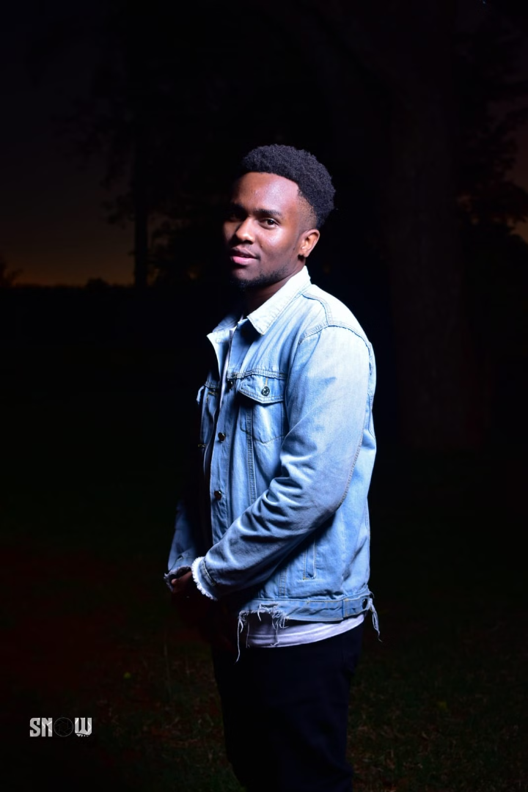


Autobiography of Antony Muchiri Njagi
My name is Antony Muchiri Njagi, and I am a highly motivated and results-oriented fourth-year student pursuing a Bachelor of Business Information Technology (BBIT) at Dedan Kimathi University of Technology (DeKUT). Born and raised in Kiambu, I have always been fascinated by the world of information technology and am eager to embark on a rewarding career in this dynamic field.
by Antony Muchiri

Slide 2
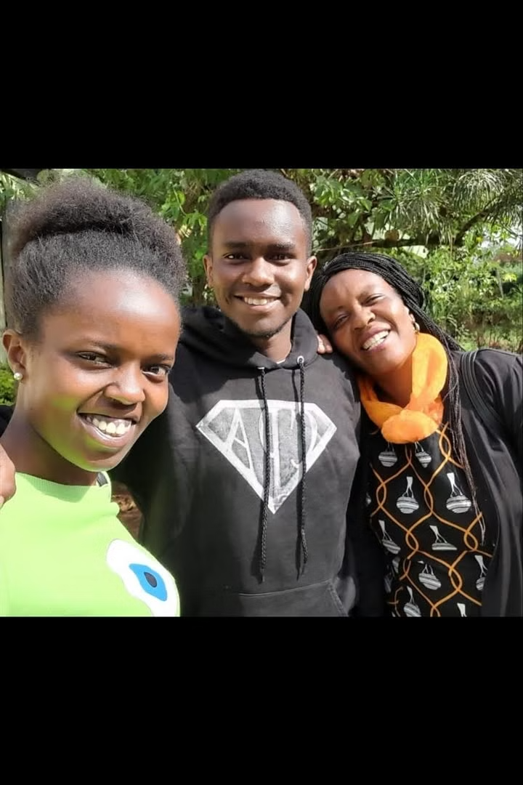
Early Years and Family Background
Nurturing Environment
I was born in August 1999 in the vibrant town of Kiambu, where I was raised in a loving and supportive family. My parents, John Njagi and Bilha Wakuhi, instilled in me the values of hard work, respect, and a deep sense of curiosity about the world around me.
Formative Years
From an early age, my parents encouraged my inquisitive nature, providing me with books, toys, and educational tools to satisfy my curiosity. My father, a veterinary doctor, and my mother, a civil servant and businesswoman, were role models who inspired me with their dedication and strong work ethic.
Family Bonds
My elder sister, Betty Wanyaga, and my younger sister, Mikyla Mumbi, have also played significant roles in shaping my life. Their achievements and diverse pursuits have broadened my horizons and motivated me to strive for excellence in my own endeavors.

Slide 3
Educational Journey
University Transformation
My decision to pursue a Bachelor of Business Information Technology (BBIT) at Dedan Kimathi University of Technology (DeKUT) has been a transformative experience. The rigorous curriculum and hands-on learning opportunities have equipped me with a comprehensive understanding of IT, business concepts, and the skills to thrive in the dynamic world of technology.
Early Foundations
My educational journey began at the nurturing environment of St. Joseph's Kabete, where I developed a love for learning. This was followed by my time at Cedar Grove Junior Academy and Naivasha Boarding School, which instilled in me the values of discipline, resilience, and a strong sense of responsibility.
1
2
3
Secondary Education
In high school, I attended Koelel High School and Rungiri Secondary School, where I continued to excel academically and actively participated in extracurricular activities. These experiences honed my leadership skills, critical thinking, and the ability to adapt to diverse environments.

Slide 4
Developing Personal and Professional Skills
Problem-Solving Expertise
Collaborative Mindset
Leadership Capabilities
Throughout my academic and personal experiences, I have honed my problem-solving skills. By approaching challenges with a strategic and analytical mindset, I have learned to break down complex issues, evaluate information from multiple perspectives, and devise innovative solutions.
Collaboration has been a crucial aspect of my development. Working effectively with diverse teams, I have learned the value of clear communication, mutual respect, and the power of collective effort in achieving common goals.
Embracing leadership roles in various settings, I have developed the ability to inspire and motivate others, make informed decisions, and manage time effectively. These skills have been instrumental in my academic and personal pursuits.

Slide 5



Expanding Horizons Beyond the Classroom
IT Expertise
Forex Trading
Automotive Passion
My passion for technology extends beyond the classroom. I have developed a deep understanding of programming languages, database management, and networking, which I continuously strive to expand through self-directed learning and practical applications.
In addition to my IT pursuits, I have a keen interest in the forex market. Through self-study and hands-on experience, I have gained valuable skills in financial analysis, risk management, and strategic decision-making, which complement my technological expertise.
My fascination with technology also extends to the automotive industry. I aspire to establish a car modification company that focuses on enhancing the aesthetics and appearance of vehicles, combining my IT skills with my passion for design and innovation.

Slide 6
Transformative Years at DeKUT
1
Comprehensive Curriculum
2
Practical Application
3
Extracurricular Engagement
Beyond theoretical knowledge, DeKUT has fostered my ability to think critically, solve problems creatively, and communicate effectively, preparing me for the dynamic world of IT.
The BBIT program at DeKUT has provided me with a deep understanding of various IT domains, including programming, database management, networking, and information systems analysis and design.
My involvement in university clubs and organizations has further enriched my experience, allowing me to apply my skills, develop leadership abilities, and contribute to meaningful projects.

Slide 7



Achievements and Challenges
Academic Excellence
Throughout my BBIT program, I have maintained a strong GPA, demonstrating my dedication to academic achievement and my ability to excel in a challenging environment.
Hands-On Experience
My participation in tech hackathons has allowed me to apply my theoretical knowledge to real-world challenges, fostering my problem-solving skills and teamwork abilities.
Overcoming Obstacles
While navigating the demands of my academic and personal pursuits, I have learned to effectively manage my time, seek help when needed, and adapt to new learning environments.

Slide 8
Career Aspirations and Future Goals
Short-Term Goals
1
Upon graduation, I aim to secure a position as a Junior Network Administrator or IT Support Specialist, where I can apply my technical knowledge and gain hands-on experience in the IT industry.
2
Long-Term Ambitions
In the future, I envision advancing my career in IT, potentially taking on roles such as IT Project Manager or Network Security Architect, where I can leverage my problem-solving skills and passion for technology to lead complex projects and develop innovative solutions.
Integrated Pursuits
3
Alongside my IT career, I plan to continue exploring my interests in the forex market and the automotive industry, integrating these diverse passions to create unique and impactful contributions in the ever-evolving technological landscape.

Slide 9

Conclusion: A Journey of Growth and Determination
As I reflect on my journey, I am filled with a deep sense of gratitude and a renewed determination to make a meaningful impact in the world of information technology. My experiences, both academic and personal, have shaped me into a well-rounded individual, equipped with the knowledge, skills, and passion to thrive in this dynamic field. I am excited to embark on the next chapter of my life, where I can leverage my diverse interests and expertise to contribute to the advancement of technology and create innovative solutions that positively impact the world around me.

